Slide 1
20 and 21 of February, Leipzig
WP 4: QUALITY

Slide 2
ISLA 2019-2022 Report
Delineated the Quality Plan (QP).
Taking in account all main Job-Jo documents, the first management meeting decisions and all relevant European standards, ISLA, with the collaboration of UCY, prepared a road map of activities, responsibilities, objectives to be attained, indicators of those objectives, target partners and due dates.
Notes:
Each partner will indicate a person

Slide 3
ISLA 2019-2022 Report
2. Designed and distributed a set of templates that evaluate and report on the efficacy and efficiency of the Management Meetings (MM) and Training activities.
3. Participated in all MM with active involvement.
Notes:
Each partner will indicate a person

Slide 4
ISLA 2019-2022 Report
4. Designed and implemented, in April 2021, a online training course aimed at the BSNB staff, with three 2-hour sessions.
BSNBs have a decisive role in worker’s qualification. Its management goes well beyond the mere administrative aspects of training.
Notes:
Each partner will indicate a person

Slide 5
ISLA 2019-2022 Report
5. Invited by UCY, analyzed the Capacity Building Plan and gave detailed feedback to the partner.
6. Evaluated all face-to-face training that occurred in European partners and sent the reports to MU and/or the Quality Committee.
Notes:
Each partner will indicate a person

Slide 6
ISLA 2019-2022 Report
7. Disseminated the project in ISLA site, ISLA social media and in internal meetings with the academia and students.
8. Visited all BSNB and is elaborating a report. Details of it to be analyzed in this meeting.
Notes:
Each partner will indicate a person

Slide 7
BSNB Visits
Between the 18th and the 24th of January 2022
All sites were visited by ISLA in its role of quality manager. In each place, we were received by the local BSNB coordinator or his/her representative who presented the space, the equipment, the activities developed since the creation of the BSNB and the university site.
Notes:
Each partner will indicate a person

Slide 8
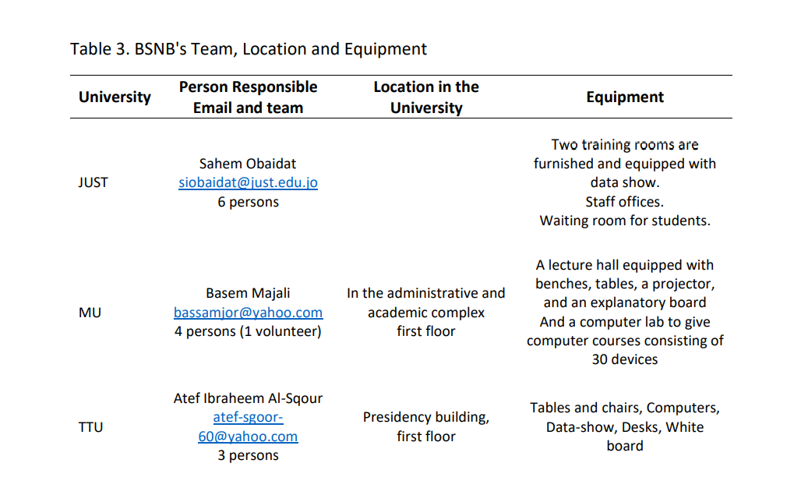
BSNB Visits
Notes:
Each partner will indicate a person

Slide 9
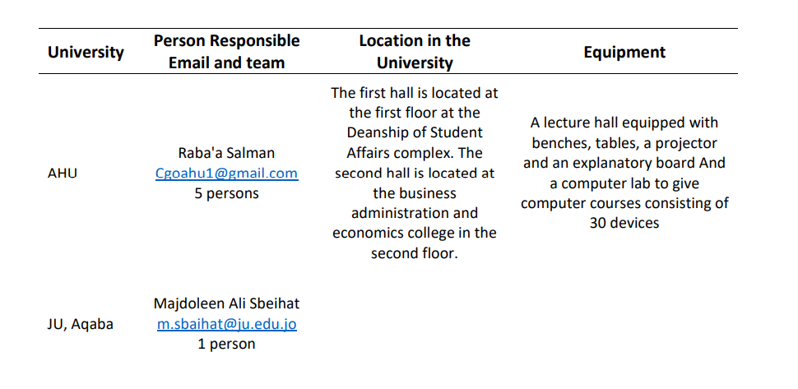
BSNB Visits
All this information was compilled after the synthesis made by the BSNBs in August 2021. Please rectify anything that changed and send us as soon as possible.
Notes:
Each partner will indicate a person

Slide 10
BSNB Visits
We prepared an extensive list of activities, based on:
BSNB presentations. After each presentation an agreement was made that they would be sent to us;
Thorough examination of information in the five Newsletters
Notes taken during the presentations
Notes:
Each partner will indicate a person

Slide 11
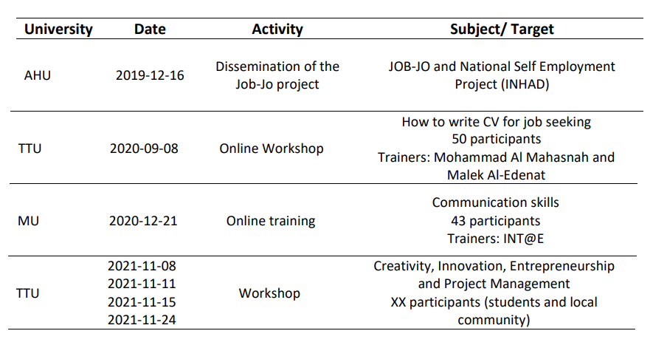
BSNB Visits
Notes:
Each partner will indicate a person

Slide 12
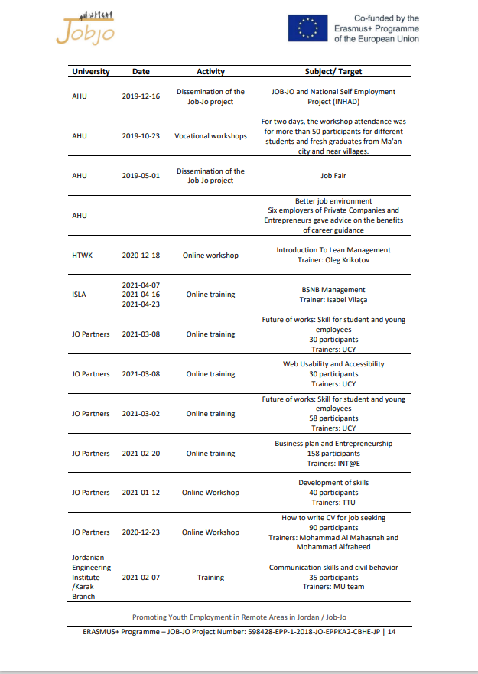
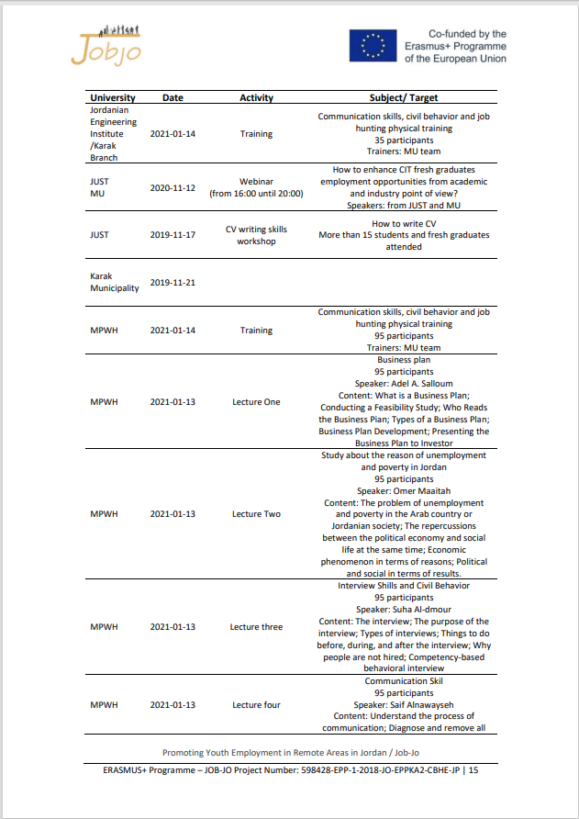
BSNB Visits: working list
Notes:
Each partner will indicate a person

Slide 13
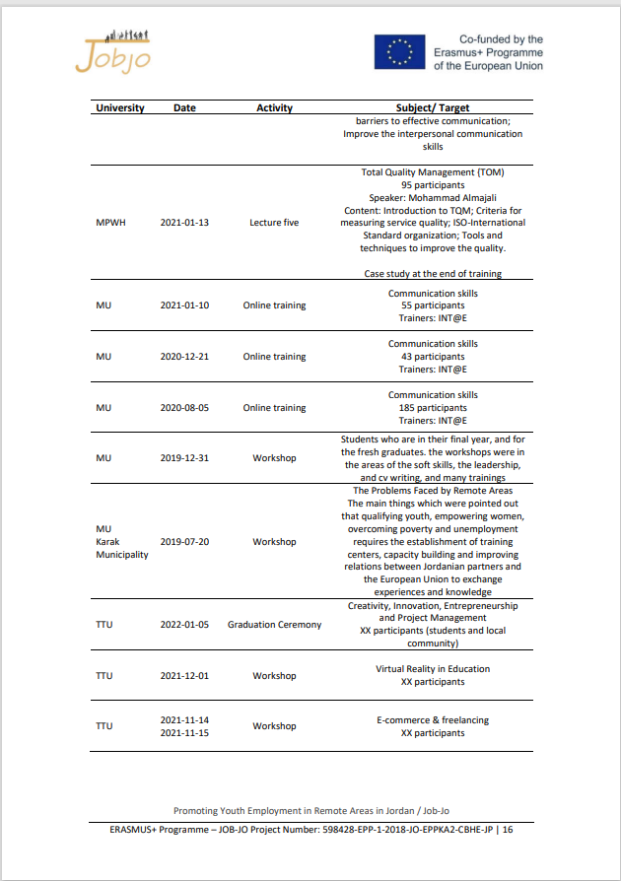
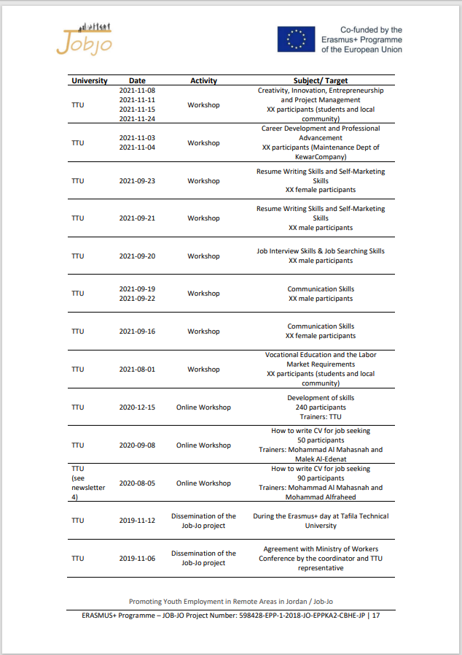
BSNB Visits: working list
Notes:
Each partner will indicate a person

Slide 14
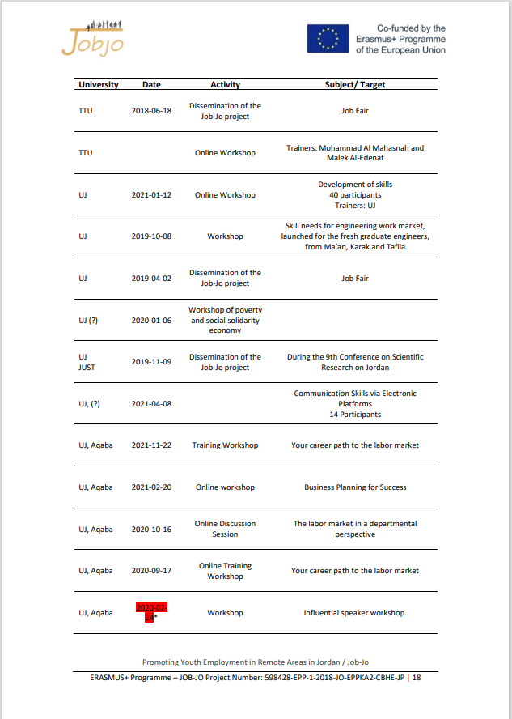
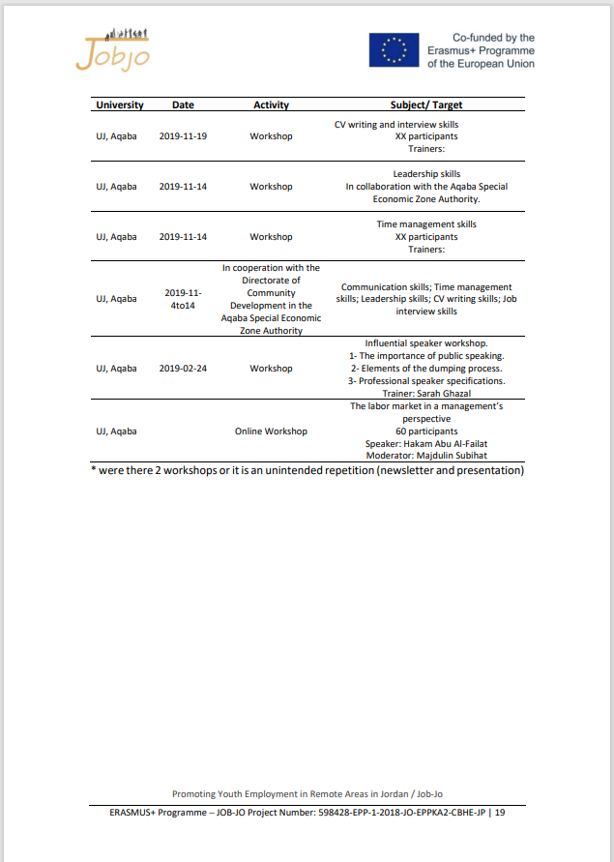
BSNB Visits: working list
Notes:
Each partner will indicate a person

Slide 15
BSNB Visits
What is needed in each training/workshop
Name of the course
Type of activity
Duration (in hours)
Participants (distributed by work status and gender)
Trainer identification
Summary of the content
Notes:
Each partner will indicate a person

Slide 16
BSNB training data,
example

Slide 17
BSNB training data
Training certificates
One from each BSNB
Training dissemination

Slide 18
ISLA face-to-face training in Portugal
Tomorrow will be discussed

Slide 19
Thank You

